Slide 1
The Nested Splat! Series
Set 18.1
This set includes Instant Nested Splats! with 1 large Splat!
Click to download the original 50 Splat! lessons or the The 20 Fraction Splat! Lessons.
Click here to download more Nested Splat! lessons.
Steve Wyborney

Slide 2
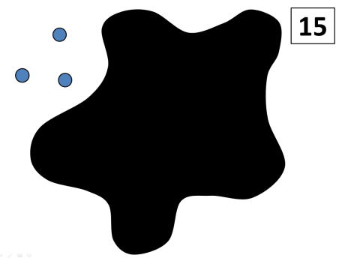
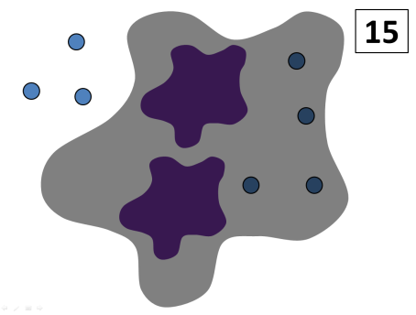
In this level, you’ll find the number of dots under the large Splat!
Then you’ll find the number of dots under
each small Splat!
This series was written in PowerPoint, so it works best if you view it using PowerPoint.
If you don’t have PowerPoint, try this link to download the free PowerPoint viewer.
Steve Wyborney

Slide 3
Splat!
15
The total number of blue dots is…
How many dots are under the splat? How do you know?
How else could you know?
Let’s look under the Splat!
Look! There are more Splats! The small Splats are the same color, so they are each covering the same number. How many dots are under each of the small splats?
How do you know?
How else could you know?
Let’s look under the small splats to see how many dots are there.
What can we learn from this picture?
www.stevewyborney.com
Steve Wyborney

Slide 4
18
www.stevewyborney.com
Steve Wyborney

Slide 5
19
www.stevewyborney.com
Steve Wyborney

Slide 6
28
www.stevewyborney.com
Steve Wyborney

Slide 7
27
www.stevewyborney.com
Steve Wyborney

Slide 8
Click to download the original 50 Splat! lessons or the The 20 Fraction Splat! Lessons.
You can find more Nested Splat! lessons here.
The Nested Splat! Series
Set 18.1
This set includes Instant Nested Splats! with 1 large Splat!
Steve Wyborney

