Slide 1
The Nested Splat! Series
Set 15.2
This set includes Nested Splats! through 10.
Click to download the original 50 Splat! lessons or the The 20 Fraction Splat! Lessons.
Click here to download more Nested Splat! lessons.
Steve Wyborney

Slide 2
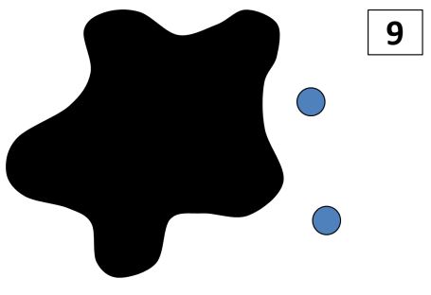
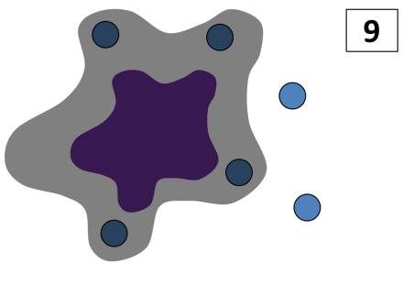
In this level, you’ll find the number of dots under the large Splat!
Then you’ll find the number of dots under the small Splat!
This series was written in PowerPoint, so it works best if you view it using PowerPoint.
If you don’t have PowerPoint, try this link to download the free PowerPoint viewer.
Steve Wyborney

Slide 3
How many blue dots do you see?
9
Splat!
How many dots are under the splat? How do you know?
How else could you know?
Let’s look under the splat to see how many dots are there.
Look! There is another Splat! We know there are 4 dots under the large splat. How many dots are under the small splat?
How do you know?
How else could you know?
Let’s look under the small splat to see how many dots are there.
What can we learn from this picture?
www.stevewyborney.com
Steve Wyborney

Slide 4
10
www.stevewyborney.com
Steve Wyborney

Slide 5
8
www.stevewyborney.com
Steve Wyborney

Slide 6
7
www.stevewyborney.com
Steve Wyborney

Slide 7
10
www.stevewyborney.com
Steve Wyborney

Slide 8
Click to download the original 50 Splat! lessons or the The 20 Fraction Splat! Lessons.
You can find more Nested Splat! lessons here.
The Nested Splat! Series
Set 15.2
This set includes Nested Splats! through 10.
Steve Wyborney

